Slide 1
New Taco Place in CDMX
Angelica Martinez
May 23, 2020

Slide 2
Introduction
Nowadays, if a person wanted to open a new business, be it a restaurant, a cafeteria, a flower shop, a hairdresser, a dental office, a pharmacy, a gym or any business that comes to mind, it is necessary to study the area where you would like your business to be located.
From my point of view, many factors need to be considered. Mexico City is one of the most overpopulated cities in the world, just in my neighborhood there is a grocery store on every corner, for every 4 streets there is a gym and so many similar cases. Opening a new business in Mexico City is a little more complicated than it seems, opening a new business implies a bit of luck, that the product you offer pleases people more to prefer your business than the competition.

Slide 3
Data acquisition and cleaning
INEGI has several sites, one of these is https://datos.cdmx.gob.mx/explore/dataset/coloniascdmx/ from where a file with .geojson extension was obtained, this is open documentation so this contained the delegations, colonies and polygons of its geographical area
Wikipedia information from https://en.wikipedia.org/wiki/List_of_neighborhoods_in_Mexico_City
Viahero https://www.viahero.com/travel-to-mexico/best-neighborhoods-in-mexico-city
Culture trip https://theculturetrip.com/north-america/mexico/articles/the-10-coolest-neighbourhoods-in-mexico-city/

Slide 4
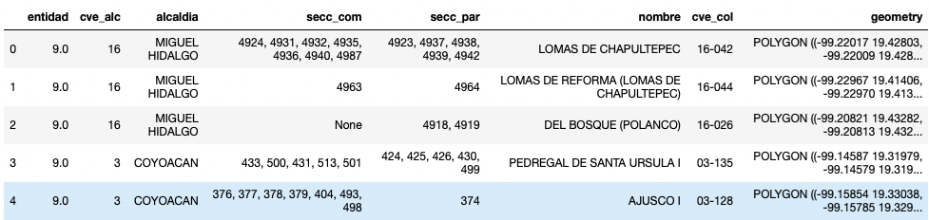
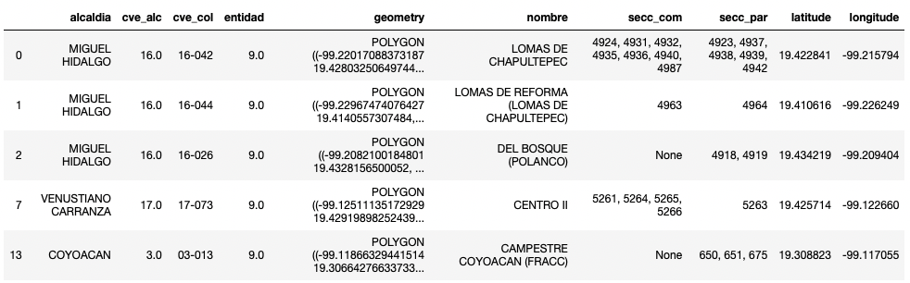
Feature selection

Slide 5
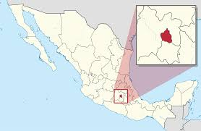
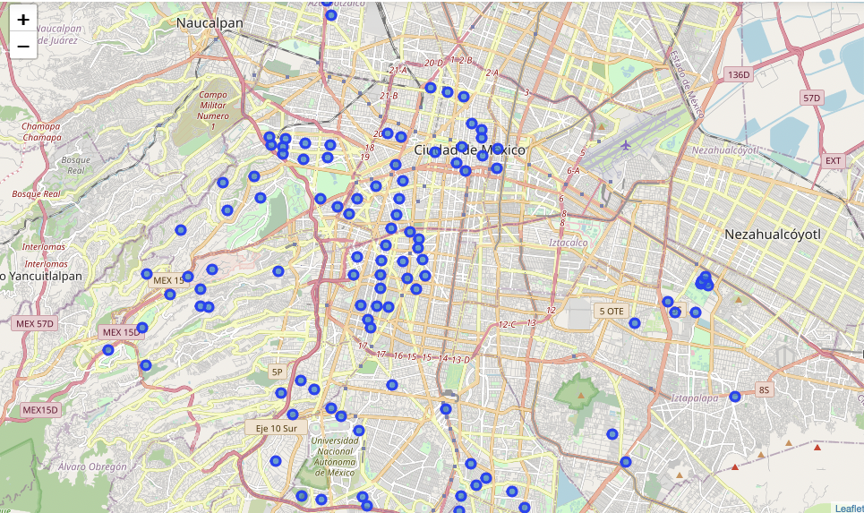
Exploratory data analysis
Considering the most popular neighborhoods, we will begin to graph these within Mexico City. Remember that geographical coordinate of CDMX are 19.4326296, - 99.1331785.

Slide 6
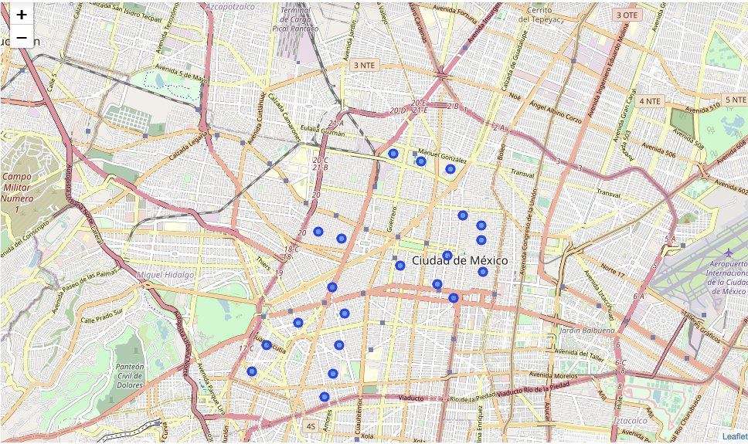
Let's concentrate on one of the "delegaciones" where the most popular "colonias" are located: Cuauhtemoc This is one of the "delegations" famous for different factors, however as it is popualr it is certain that there will be a greater amount of population. Below we can see the result only of the "colonias" within the Cuauhtemoc delegation.

Slide 7
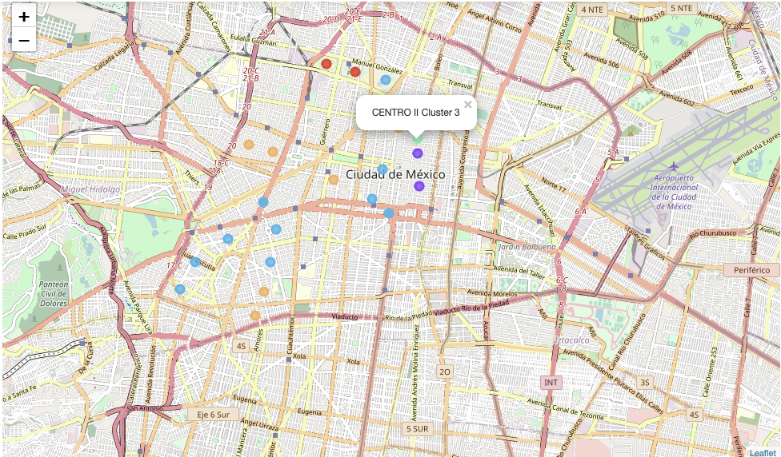
Analysis
Analyzing the result of cluster 1, we can see that if we wanted to open a new taco place in this geographical area, we would have enough competition.

Slide 8
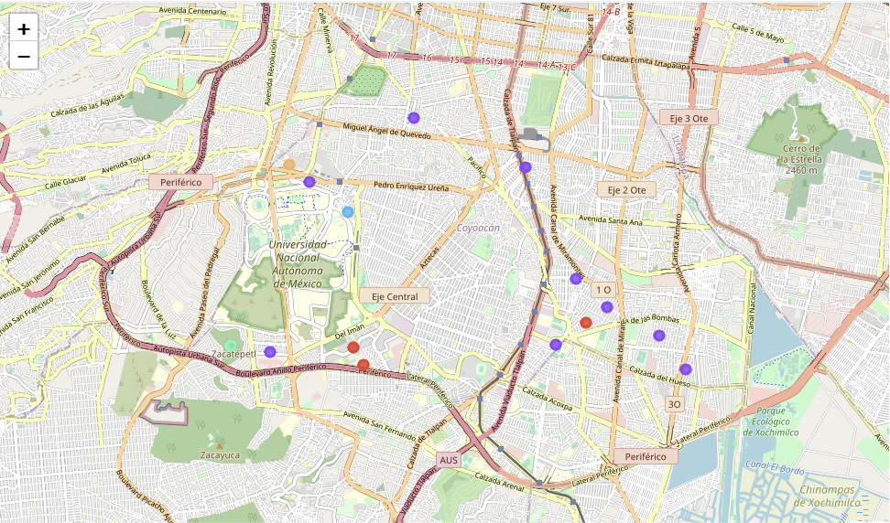
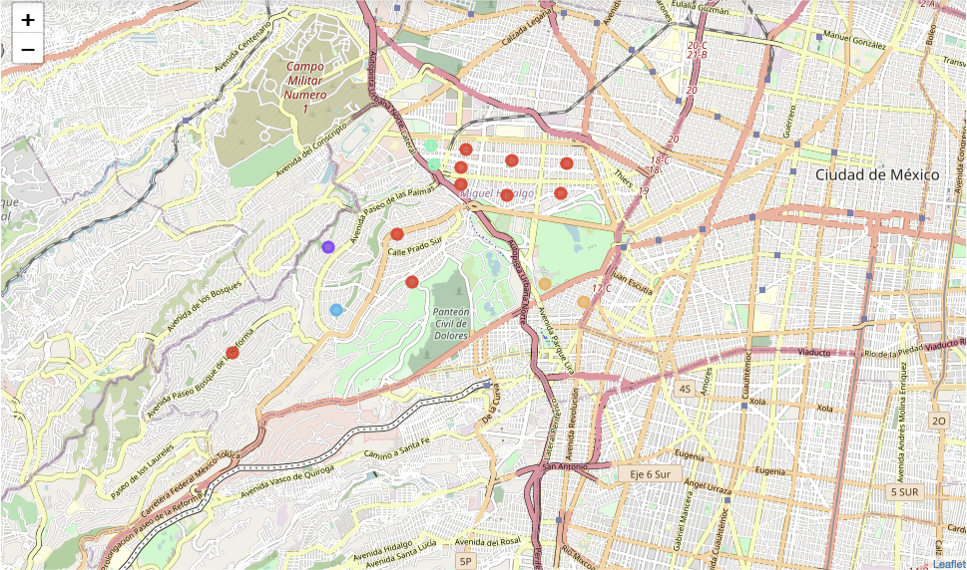
More Analysis
This image is the map with the results of clustering k = 5 in Coyoacan.
This image is the map with the results of clustering k = 5 in Miguel Hidalgo.

Slide 9
Conclusion and future decisions
We can determine that the neighborhoods where there is no nearby 'taco' place would be in the POLANCO neighborhood of the 'delegation' Miguel Hidalgo, the second option would be SAN ANGEL of the 'delegation' COYOACAN, and an option where we apparently do not have almost no competition would be in practically the entire CUAJIMALPA 'delegation'.
Consider population in neighborhoods
Consider crime levels in neighborhoods
Consider socioeconomic status by neighborhood

